Slide 1
Outline
Introduction
Background
Distributed Database Design
Database Integration
Semantic Data Control
Distributed Query Processing
Multidatabase Query Processing
Query Rewriting
Optimization Issues
Distributed Transaction Management
Data Replication
Parallel Database Systems
Distributed Object DBMS
Peer-to-Peer Data Management
Web Data Management
Current Issues

Slide 2
Multidatabase Query Processing
Mediator/wrapper architecture
MDB query processing architecture
Query rewriting using views
Query optimization and execution
Query translation and execution

Slide 3
Mediator/Wrapper Architecture
Mediator
Same
Interface
Different
Interfaces
Query
Processing
Local
Schema
Wrapper1
DBMS1
Query
Global
local
schema
Wrapper2
DBMS2
view
Results
local
schema
Wrapper3
DBMS3
Result
Integration
DBMS4

Slide 4
Advantages of M/W Architecture
Wrappers encapsulate the details of component DBMS
Export schema and cost information
Manage communication with Mediator
Mediator provides a global view to applications and users
Single point of access
May be itself distributed
Can specialize in some application domain
Perform query optimization using global knowledge
Perform result integration in a single format

Slide 5
Issues in MDB Query Processing
Component DBMSs are autonomous and may range from full-fledge relational DBMS to flat file systems
Different computing capabilities
Prevents uniform treatment of queries across DBMSs
Different processing cost and optimization capabilities
Makes cost modeling difficult
Different data models and query languages
Makes query translation and result integration difficult
Different runtime performance and unpredictable behavior
Makes query execution difficult

Slide 6
Component DBMS Autonomy
Communication autonomy
The ability to terminate services at any time
How to answer queries completely?
Design autonomy
The ability to restrict the availability and accuracy of information needed for query optimization
How to obtain cost information?
Execution autonomy
The ability to execute queries in unpredictable ways
How to adapt to this?

Slide 7
Mediator Data Model
Relational model
Simple and regular data structures
Mandatory schema
Object model
Complex (graphs) and regular data structures
Mandatory schema
Semi-structured (XML) model
Complex (trees) and irregular data structures
Optional schema (DTD or XSchema)
In this chapter, we use the relational model which is sufficient to explain MDB query processing

Slide 8
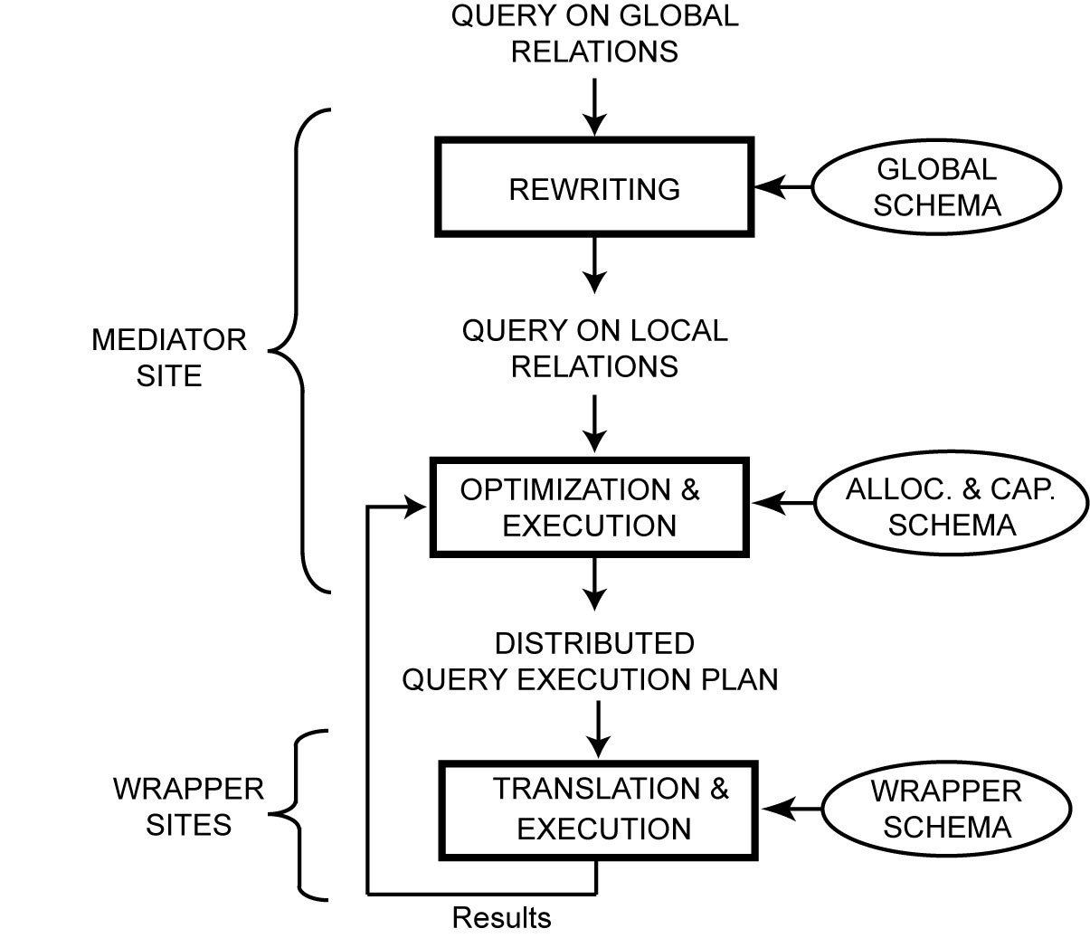
MDB Query Processing Architecture
Global/local correspondences
Allocation and capabilities
Local/DBMS mappings

Slide 9
Query Rewriting Using Views
Views used to describe the correspondences between global and local relations
Global As View: the global schema is integrated from the local databases and each global relation is a view over the local relations
Local As View: the global schema is defined independently of the local databases and each local relation is a view over the global relations
Query rewriting best done with Datalog, a logic-based language
More expressive power than relational calculus
Inline version of relational domain calculus

Slide 10
Datalog Terminology
Conjunctive (SPJ) query: a rule of the form
Q(T) :- R₁(T₁), … R_{n}(T_{n})
Q(T) : head of the query denoting the result relation
R₁(T₁), … R_{n}(T_{n}): subgoals in the body of the query
R₁, … R_{n}: predicate names corresponding to relation names
T₁, … T_{n}: refer to tuples with variables and constants
Variables correspond to attributes (as in domain calculus)
“-” means unnamed variable
Disjunctive query = n conjunctive queries with same head predicate

Slide 11
Datalog Example
With EMP(ENAME,TITLE,CITY) and ASG(ENAME,PNAME,DUR)
SELECT ENAME,TITLE, PNAME
FROM EMP, ASG
WHERE EMP.ENAME = ASG.ENAME
AND TITLE = "Programmer" OR DUR=24
Q(ename,title,pname) :- Emp(ename,title,-)
Asg(ename,pname,-),
title = “Programmer”.
Q(ename,title,pname) :- Emp(ename,title,-)
Asg(ename,pname,24).

Slide 12
Rewriting in GAV
Global schema similar to that of homogeneous DDBMS
Local relations can be fragments
But no completeness: a tuple in the global relation may not exist in local relations
Yields incomplete answers
And no disjointness: the same tuple may exist in different local databases
Yields duplicate answers
Rewriting (unfolding)
Similar to query modification
Apply view definition rules to the query and produce a union of conjunctive queries, one per rule application
Eliminate redundant queries

Slide 13
GAV Example Schema
Global relations
EMP(ENAME,CITY)
ASG(ENAME,PNAME,TITLE, DUR)
Local relations
EMP1(ENAME,TITLE,CITY)
EMP2(ENAME,TITLE,CITY)
ASG1(ENAME,PNAME,DUR)
Emp(ename,city) :- Emp1(ename,title,city). (r₁)
Emp(ename,city) :- Emp2(ename,title,city). (r₂)
Asg(ename,pname,title,dur) :- Emp1(ename,title,city), (r₃)
Asg1(ename,pname,dur).
Asg(ename,pname,title,dur) :- Emp2(ename,title,city), (r₄)
Asg1(ename,pname,dur).

Slide 14
GAV Example Query
Let Q: name and project for employees in Paris
Q(e,p) :- Emp(e,“Paris”), Asg(e,p,-,-).
Unfolding produces Q’
Q’(e,p) :- Emp1(e,-,“Paris”), Asg1(e,p,-,). (q₁)
Q’(e,p) :- Emp2(e,-,“Paris”), Asg1(e,p,-,). (q₂)
where
q₁ is obtained by applying r₃ only or both r₁ and r₃
In the latter case, there are redundant queries
same for q₂ with r₂ only or both r₂ and r₄

Slide 15
Rewriting in LAV
More difficult than in GAV
No direct correspondence between the terms in GS (emp, ename) and those in the views (emp1, emp2, ename)
There may be many more views than global relations
Views may contain complex predicates to reflect the content of the local relations
e.g. a view Emp3 for only programmers
Often not possible to find an equivalent rewriting
Best is to find a maximally-contained query which produces a maximum subset of the answer
e.g. Emp3 can only return a subset of the employees

Slide 16
Rewriting Algorithms
The problem to find an equivalent query is NP-complete in the number of views and number of subgoals of the query
Thus, algorithms try to reduce the numbers of rewritings to be considered
Three main algorithms
Bucket
Inverse rule
MiniCon

Slide 17
LAV Example Schema
Local relations
EMP1(ENAME,TITLE,CITY)
EMP2(ENAME,TITLE,CITY)
ASG1(ENAME,PNAME,DUR)
Global relations
EMP(ENAME,CITY)
ASG(ENAME,PNAME,TITLE, DUR)
Emp1(ename,title,city) :- Emp(ename,city), (r₁)
Asg(ename,-,title,-).
Emp2(ename,title,city) :- Emp(ename,city), (r₂) Asg(ename,-,title,-).
Asg1(ename,pname,dur) :- Asg(ename,pname,-,dur) (r₃)

Slide 18
Bucket Algorithm
Considers each predicate of the query Q independently to select only the relevant views
Step 1
Build a bucket b for each subgoal q of Q that is not a comparison predicate
Insert in b the heads of the views which are relevant to answer q
Step 2
For each view V of the Cartesian product of the buckets, produce a conjunctive query
If it is contained in Q, keep it
The rewritten query is a union of conjunctive queries

Slide 19
LAV Example Query
Let Q be Q(e,p) :- Emp(e, “Paris”), Asg(e,p,-,-).
Step1: we obtain 2 buckets (one for each subgoal of Q)
b₁ = Emp1(ename,title’,city), Emp2(ename,title’,city)
b₂ = Asg1(ename,pname,dur’)
(the prime variables (title’ and dur’) are not useful)
Step2: produces
Q’(e,p) :- Emp1(e,-, “Paris”), Asg1(e,p,-,). (q₁)
Q’(e,p) :- Emp2(e,-, “Paris”), Asg1(e,p,-,). (q₂)

Slide 20
Query Optimization and Execution
Takes a query expressed on local relations and produces a distributed QEP to be executed by the wrappers and mediator
Three main problems
Heterogeneous cost modeling
To produce a global cost model from component DBMS
Heterogeneous query optimization
To deal with different query computing capabilities
Adaptive query processing
To deal with strong variations in the execution environment

Slide 21
Heterogeneous Cost Modeling
Goal: determine the cost of executing the subqueries at component DBMS
Three approaches
Black-box: treats each component DBMS as a black-box and determines costs by running test queries
Customized: customizes an initial cost model
Dynamic: monitors the run-time behavior of the component DBMS and dynamically collect cost information

Slide 22
Black-box Approach
Define a logical cost expression
Cost = init cost + cost to find qualifying tuples
+ cost to process selected tuples
The terms will differ much with different DBMS
Run probing queries on component DBMS to compute cost coefficients
Count the numbers of tuples, measure cost, etc.
Special case: sample queries for each class of important queries
Use of classification to identify the classes
Problems
The instantiated cost model (by probing or sampling) may change over time
The logical cost function may not capture important details of component DBMS

Slide 23
Customized Approach
Relies on the wrapper (i.e. developer) to provide cost information to the mediator
Two solutions
Wrapper provides the logic to compute cost estimates
Access_cost = reset + (card-1)*advance
reset = time to initiate the query and receive a first tuple
advance = time to get the next tuple (advance)
card = result cardinality
Hierarchical cost model
Each node associates a query pattern with a cost function
The wrapper developer can give cost information at various levels of details, depending on knowledge of the component DBMS

Slide 24
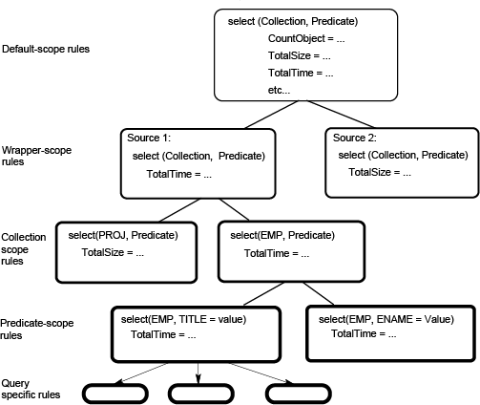
Hierarchical Cost Model

Slide 25
Dynamic Approach
Deals with execution environment factors which may change
Frequently: load, throughput, network contention, etc.
Slowly: physical data organization, DB schemas, etc.
Two main solutions
Extend the sampling method to consider some new queries as samples and correct the cost model on a regular basis
Use adaptive query processing which computes cost during query execution to make optimization decisions

Slide 26
Heterogeneous Query Optimization
Deals with heterogeneous capabilities of component DBMS
One DBMS may support complex SQL queries while another only simple select on one fixed attribute
Two approaches, depending on the M/W interface level
Query-based
All wrappers support the same query-based interface (e.g. ODBC or SQL/MED) so they appear homogeneous to the mediator
Capabilities not provided by the DBMS must be supported by the wrappers
Operator-based
Wrappers export capabilities as compositions of operators
Specific capabilities are available to mediator
More flexibility in defining the level of M/W interface

Slide 27
Query-based Approach
We can use 2-step query optimization with a heterogeneous cost model
But centralized query optimizers produce left-linear join trees whereas in MDB, we want to push as much processing in the wrappers, i.e. exploit bushy trees
Solution: convert a left-linear join tree into a bushy tree such that
The initial total cost of the QEP is maintained
The response time is improved
Algorithm
Iterative improvement of the initial left-linear tree by moving down subtrees while response time is improved

Slide 28
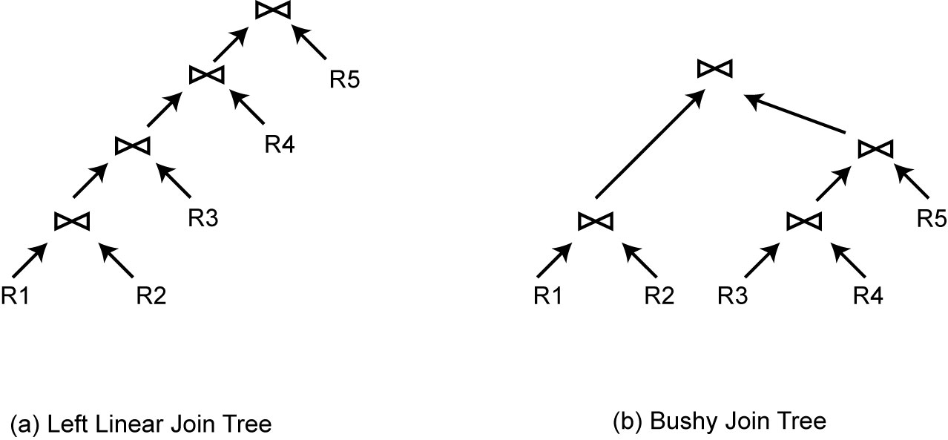
Left Linear vs Bushy Join Tree

Slide 29
Operator-based Approach
M/W communication in terms of subplans
Use of planning functions (Garlic)
Extension of cost-based centralized optimizer with new operators
Create temporary relations
Retrieve locally stored data
Push down operators in wrappers
accessPlan and joinPlan rules
Operator nodes annotated with
Location of operands, materialization, etc.

Slide 30
Planning Functions Example
Consider 3 component databases with 2 wrappers:
w₁ .db₁: EMP(ENO,ENAME,CITY)
w₁ .db₂: ASG(ENO,PNAME,DUR)
w₂ . db₃: EMPASG(ENAME,CITY,PNAME,DUR)
Planning functions of w₁
AccessPlan (R: rel, A: attlist, P: pred) = scan(R, A, P, db(R))
JoinPlan (R₁, R₂: rel, A: attlist, P: joinpred) = join(R₁, R₂, A, P)
condition: db(R₁) ≠ db(R₂)
implemented by w₁
Planning functions of w₂
AccessPlan (R: rel, A: attlist, P: pred) = fetch(city=c)
condition: (city=c) included in P
AccessPlan (R: rel, A: attlist, P: pred) = scan(R, A, P, db(R))
implemented by w₂

Slide 31
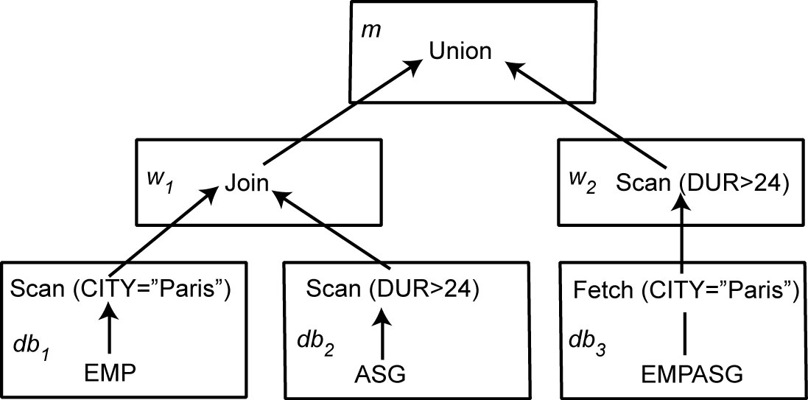
Heterogenous QEP
SELECT ENAME,PNAME,DUR
FROM EMPASG
WHERE CITY = "Paris" AND DUR>24

Slide 32
Adaptive Query Processing - Motivations
Assumptions underlying heterogeneous query optimization
The optimizer has sufficient knowledge about runtime
Cost information
Runtime conditions remain stable during query execution
Appropriate for MDB systems with few data sources in a controlled environment
Inappropriate for changing environments with large numbers of data sources and unpredictable runtime conditions

Slide 33
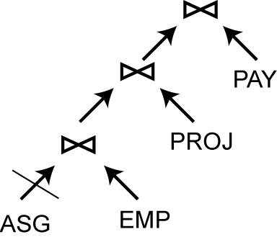
Example: QEP with Blocked Operator
Assume ASG, EMP, PROJ and PAY each at a different site
If ASG site is down, the entire pipeline is blocked
However, with some reorganization, the join of EMP and PAY could be done while waiting for ASG

Slide 34
Adaptive Query Processing – Definition
A query processing is adaptive if it receives information from the execution environment and determines its behavior accordingly
Feed-back loop between optimizer and runtime environment
Communication of runtime information between mediator, wrappers and component DBMS
Hard to obtain with legacy databases
Additional components
Monitoring, assessment, reaction
Embedded in control operators of QEP
Tradeoff between reactiveness and overhead of adaptation

Slide 35
Adaptive Components
Monitoring parameters (collected by sensors in QEP)
Memory size
Data arrival rates
Actual statistics
Operator execution cost
Network throughput
Adaptive reactions
Change schedule
Replace an operator by an equivalent one
Modify the behavior of an operator
Data repartitioning

Slide 36
Eddy Approach
Query compilation: produces a tuple ⟨D, P, C, Eddy⟩
D: set of data sources (e.g. relations)
P: set of predicates
C: ordering constraints to be followed at runtime
Eddy: n-ary operator between D and P
Query execution: operator ordering on a tuple basis using Eddy
On-the-fly tuple routing to operators based on cost and selectivity
Change of join ordering during execution
Requires symmetric join algorithms such Ripple joins

Slide 37
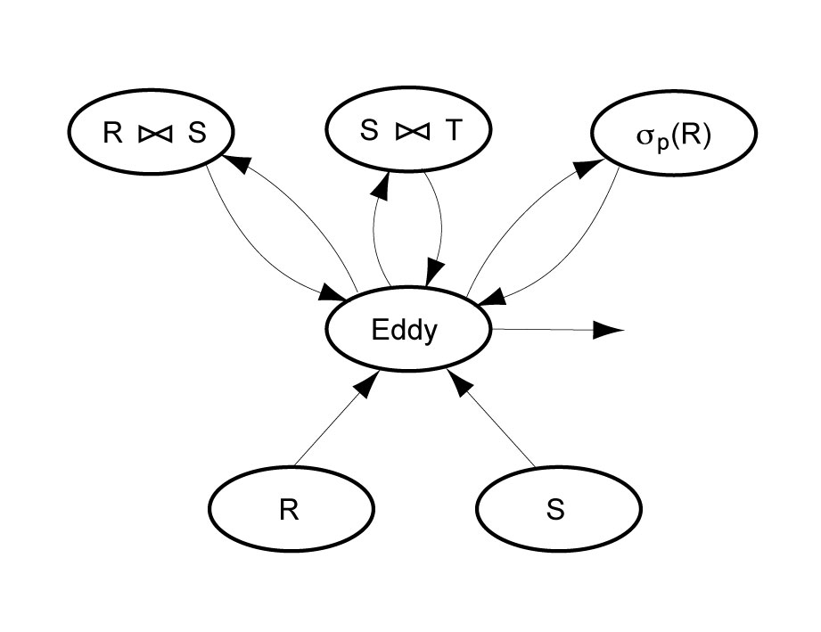
QEP with Eddy
D= {R, S, T}
P = {σ_{P} (R), R JN₁ S, S JN₂ T)
C = {S < T} where < imposes S tuples to probe T tuples using an index on join attribute
Access to T is wrapped by JN
Result tuples

Slide 38
Query Translation and Execution
Performed by wrappers using the component DBMS
Conversion between common interface of mediator and DBMS-dependent interface
Query translation from wrapper to DBMS
Result format translation from DBMS to wrapper
Wrapper has the local schema exported to the mediator (in common interface) and the mapping to the DBMS schema
Common interface can be query-based (e.g. ODBC or SQL/MED) or operator-based
In addition, wrappers can implement operators not supported by the component DBMS, e.g. join

Slide 39
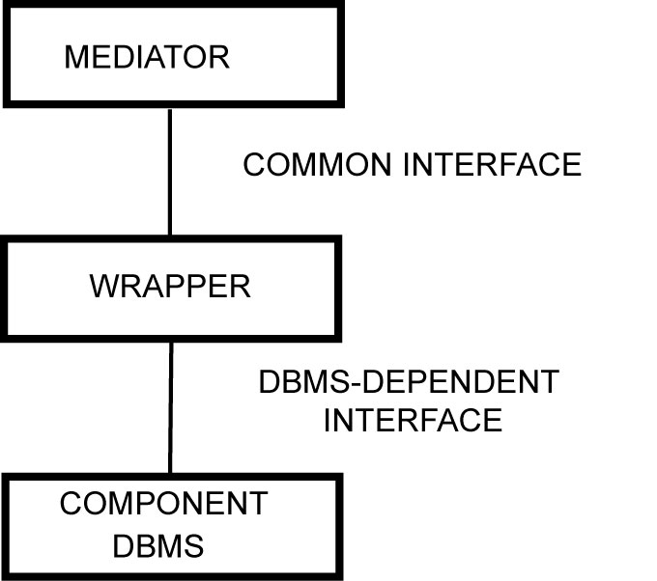
Wrapper Placement
Depends on the level of autonomy of component DB
Cooperative DB
May place wrapper at component DBMS site
Efficient wrapper-DBMS com.
Uncooperative DB
May place wrapper at mediator
Efficient mediator-wrapper com.
Impact on cost functions

Slide 40
SQL Wrapper for Text Files
Consider EMP (ENO, ENAME, CITY) stored in a Unix text file in componentDB
Each EMP tuple is a line in the file, with attributes separated by “:”
SQL/MED definition of EMP
CREATE FOREIGN TABLE EMP
ENO INTEGER, ENAME VARCHAR(30), CITY CHAR(30)
SERVER componentDB
OPTIONS (Filename ‘/usr/EngDB/emp.txt’, Delimiter ‘:’)
The query
SELECT ENAME FROM EMP
Can be translated by the wrapper using a Unix shell command
Cut –d: -f2/ usr/EngDB/emp

Slide 41
Wrapper Management Issues
Wrappers mostly used for read-only queries
Makes query translation and wrapper construction easy
DBMS vendors provide standard wrappers
ODBC, JDBC, ADO, etc.
Updating makes wrapper construction harder
Problem: heterogeneity of integrity constraints
Implicit in some legacy DB
Solution: reverse engineering of legacy DB to identify implicit constraints and translate in validation code in the wrapper
Wrapper maintenance
schema mappings can become invalid as a result of changes in component DB schemas
Use detection and correction, using mapping maintenance techniques

